Slide 1
A Foreign Field watered by our blood
A talk by Doug Smith MBE 25th April 2015

Slide 2
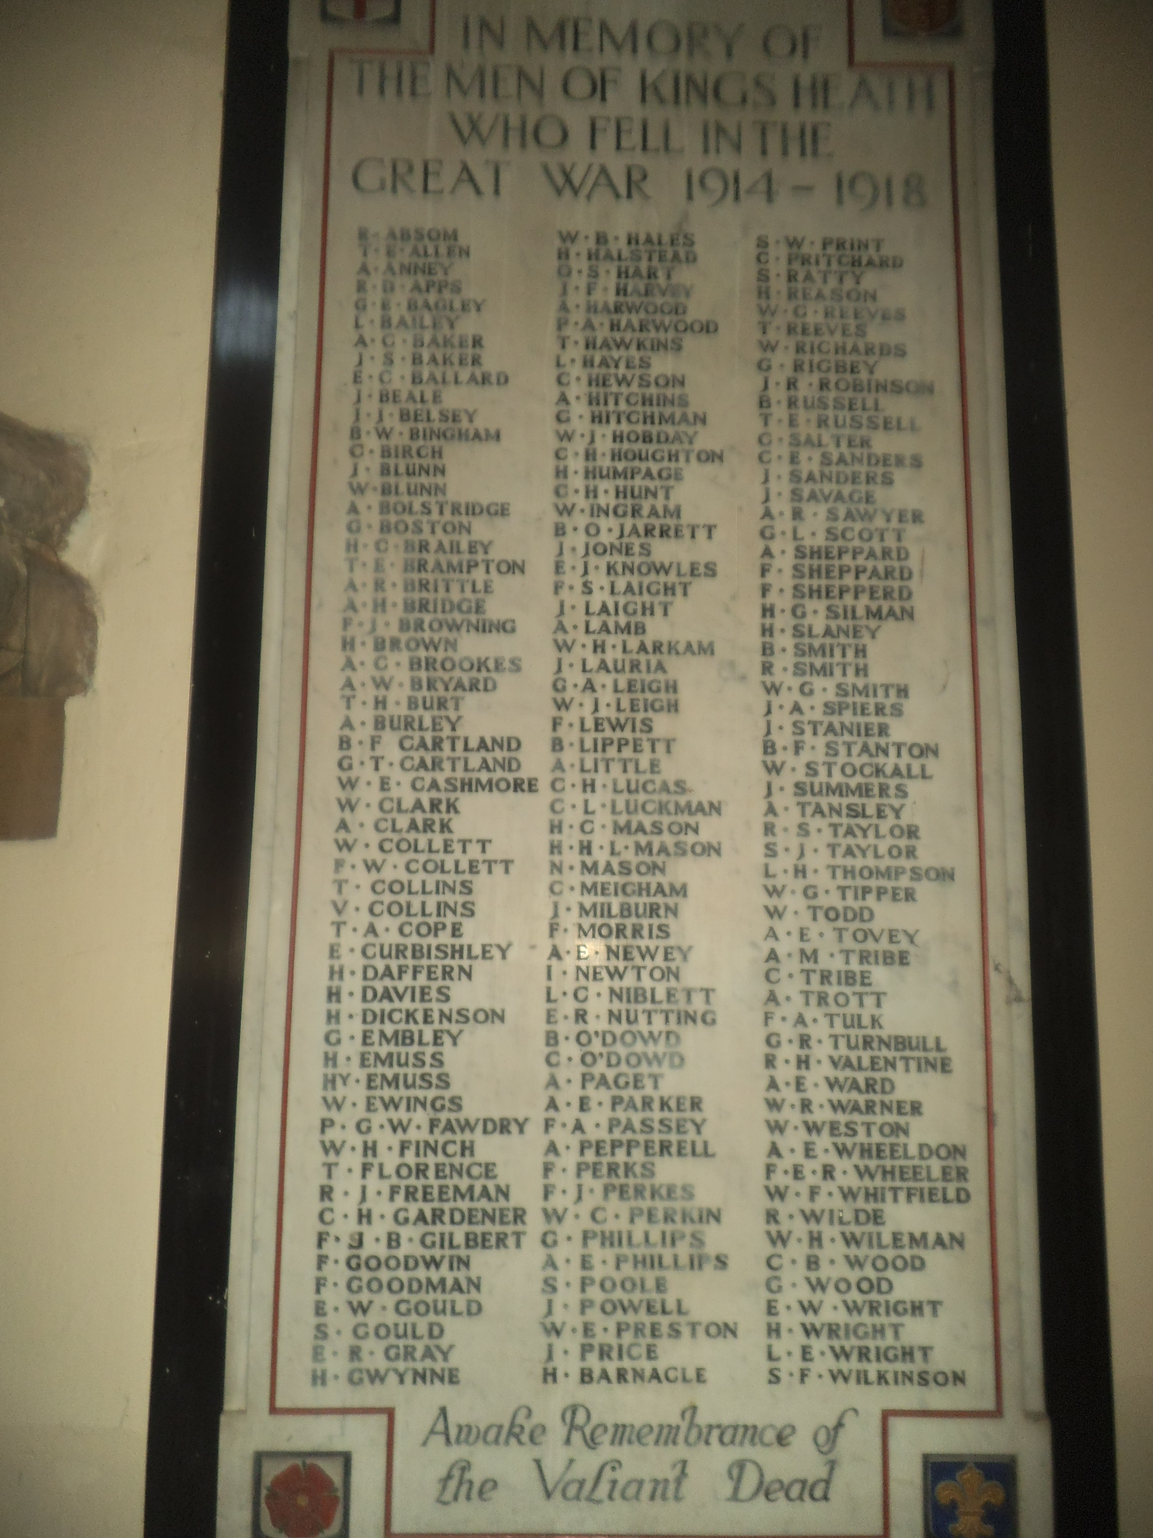
All Saints War Memorial
T E Russell
J Summers
C H Hunt
F S Laight

Slide 3
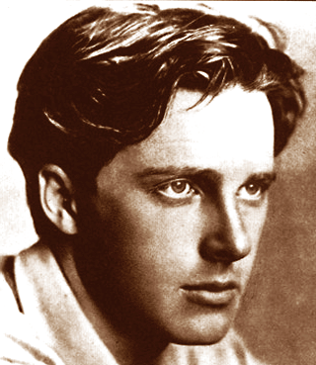
If I should die, think only this of me:
That there's some corner of a foreign field
That is for ever England. There shall be
In that rich earth a richer dust concealed;
A dust whom England bore, shaped, made aware,
Gave, once, her flowers to love, her ways to roam,
A body of England's, breathing English air,
Washed by the rivers, blest by suns of home.

Slide 4
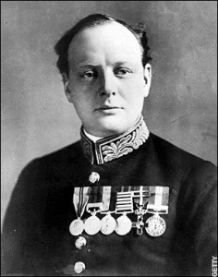
A cunning plan
Winter 1914 – deadlock on the Western Front
Russia suffering a heavy defeat in the East.
January 1915 - Winston Churchill, First Lord of the Admiralty – using British sea power to attack the Central Alliance’s southern flank, knock Turkey out of the war and open up a supply route to Russia.

Slide 5
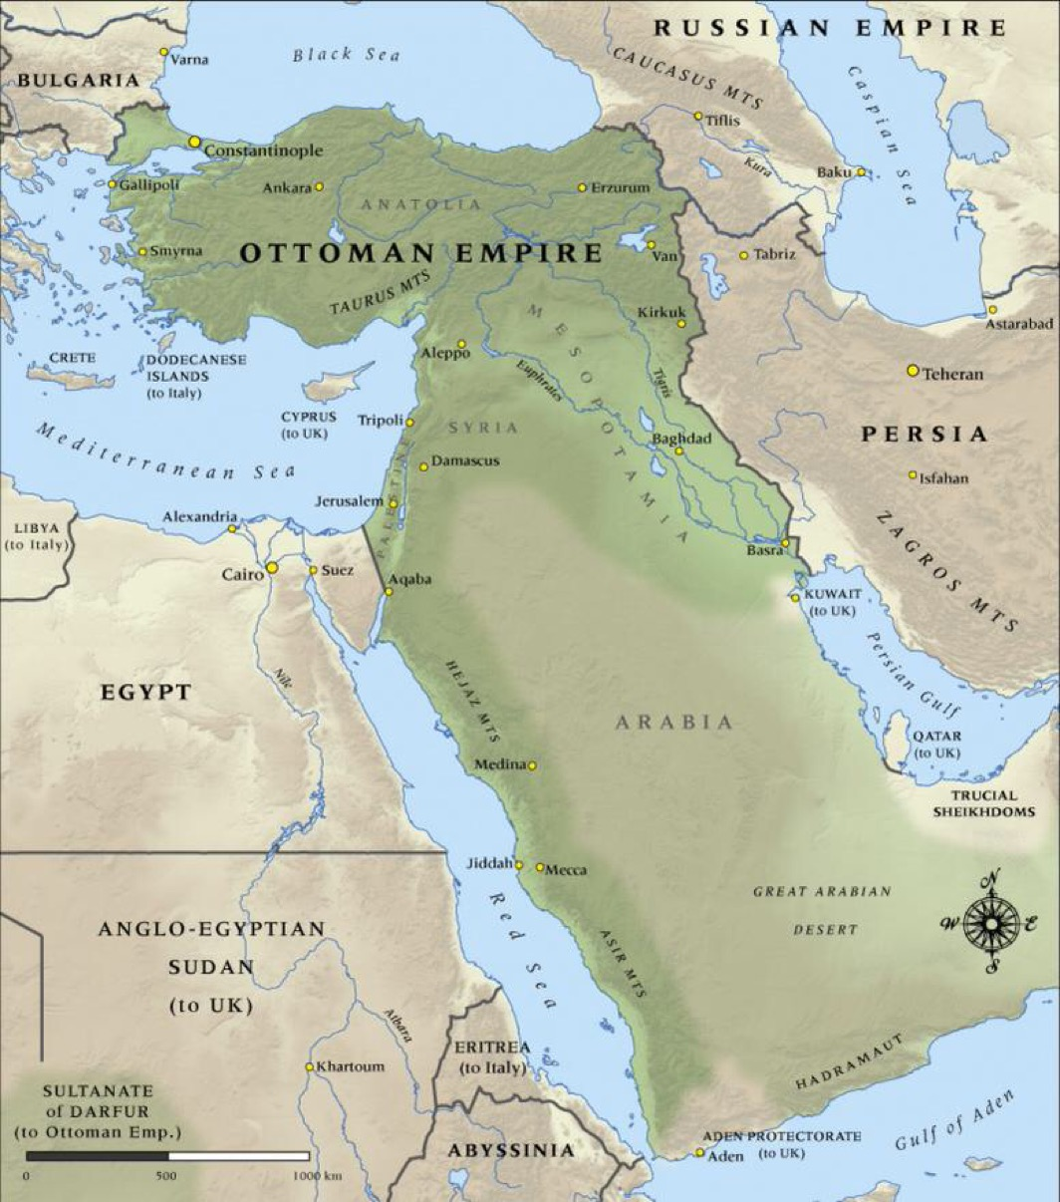
A good idea!

Slide 6
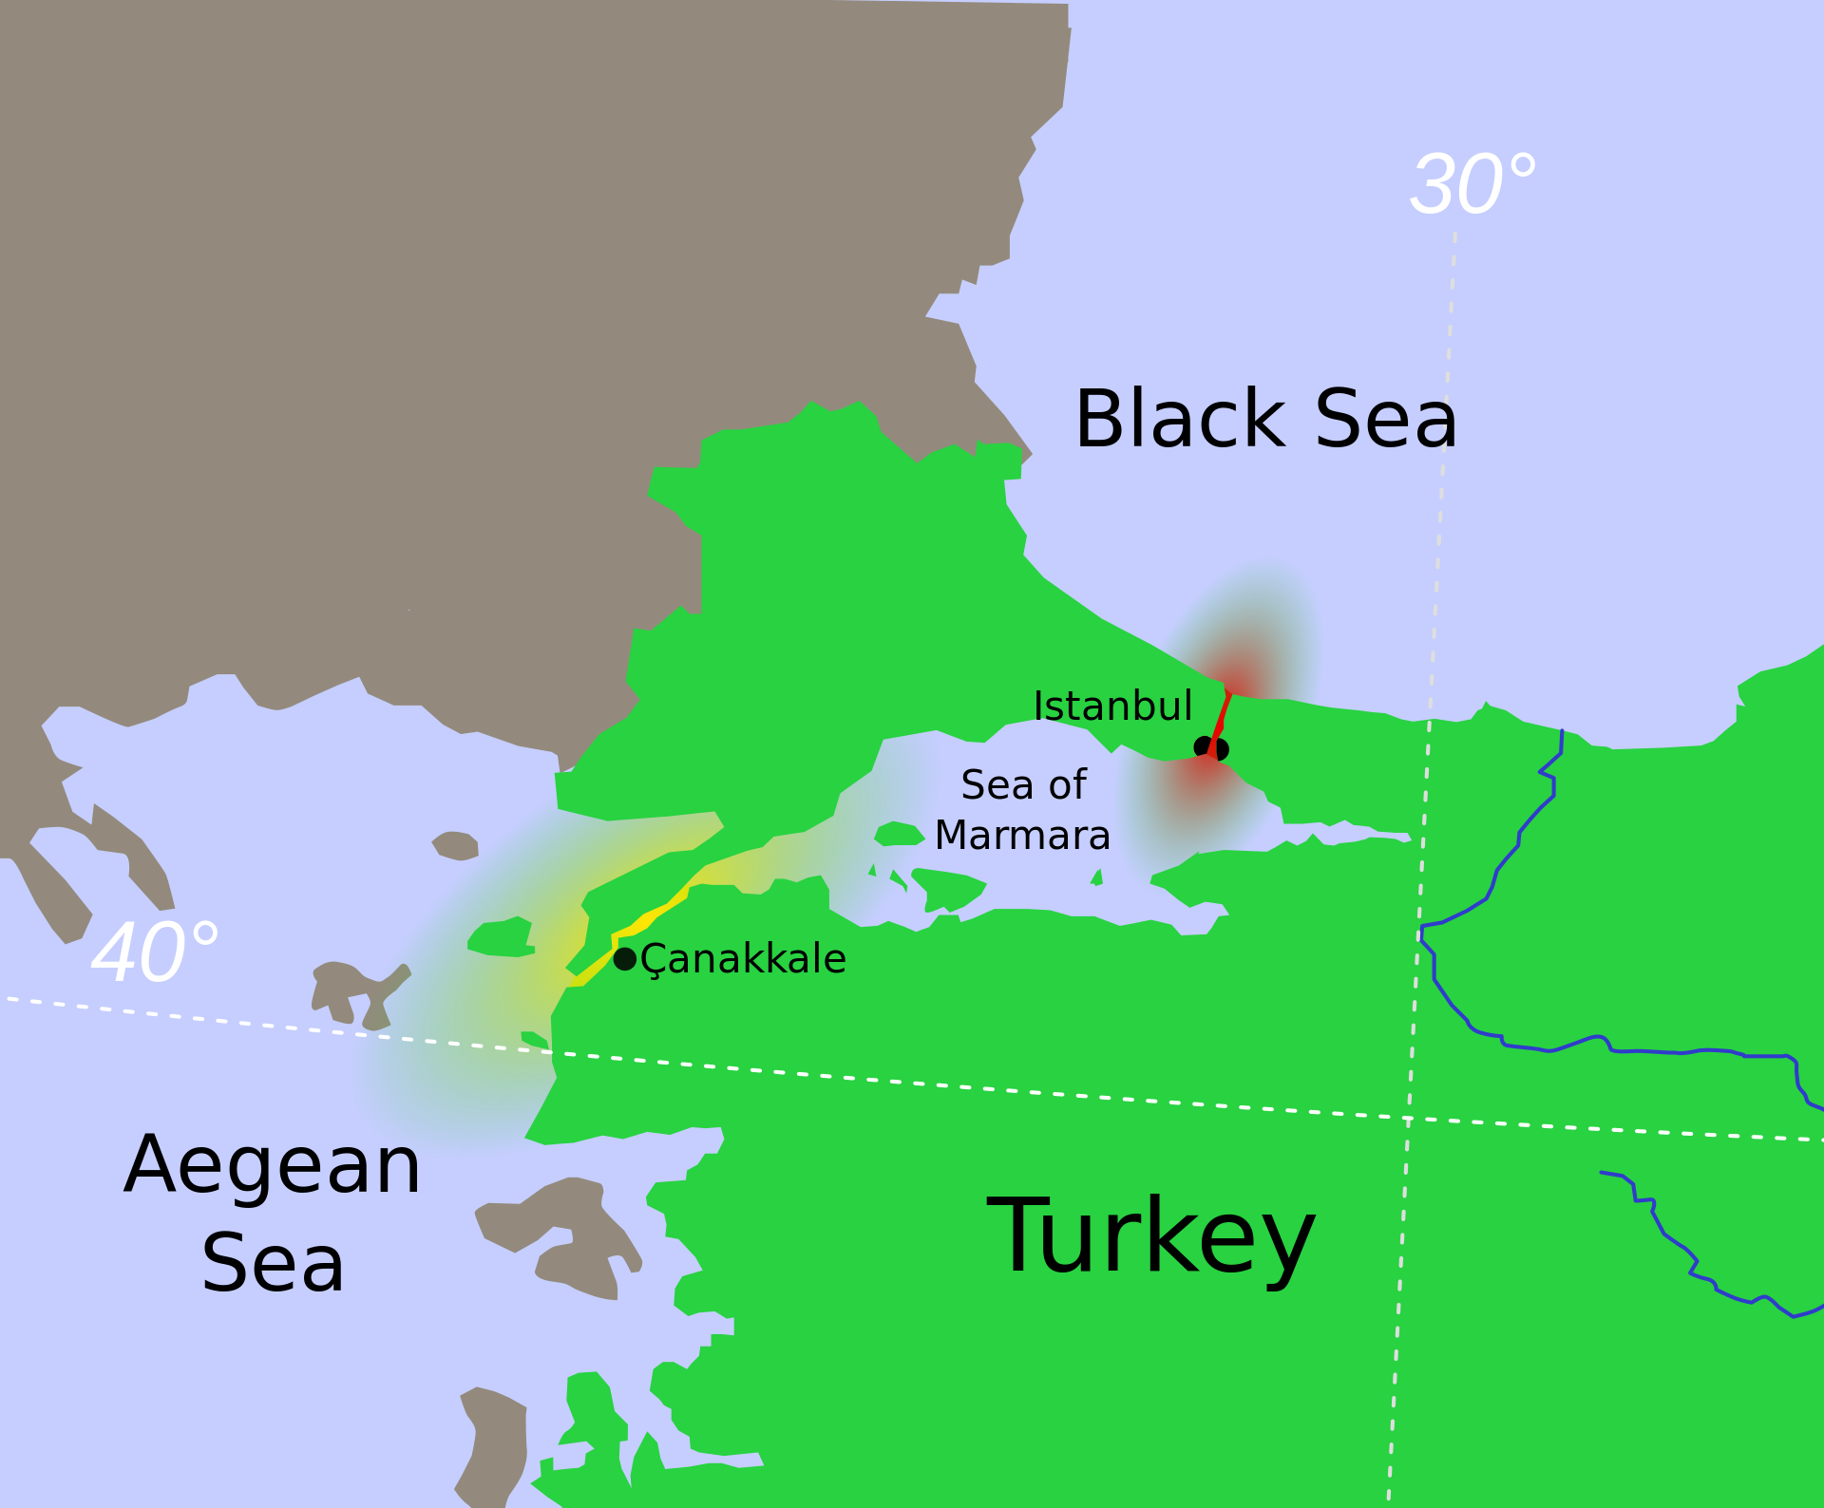

Slide 7
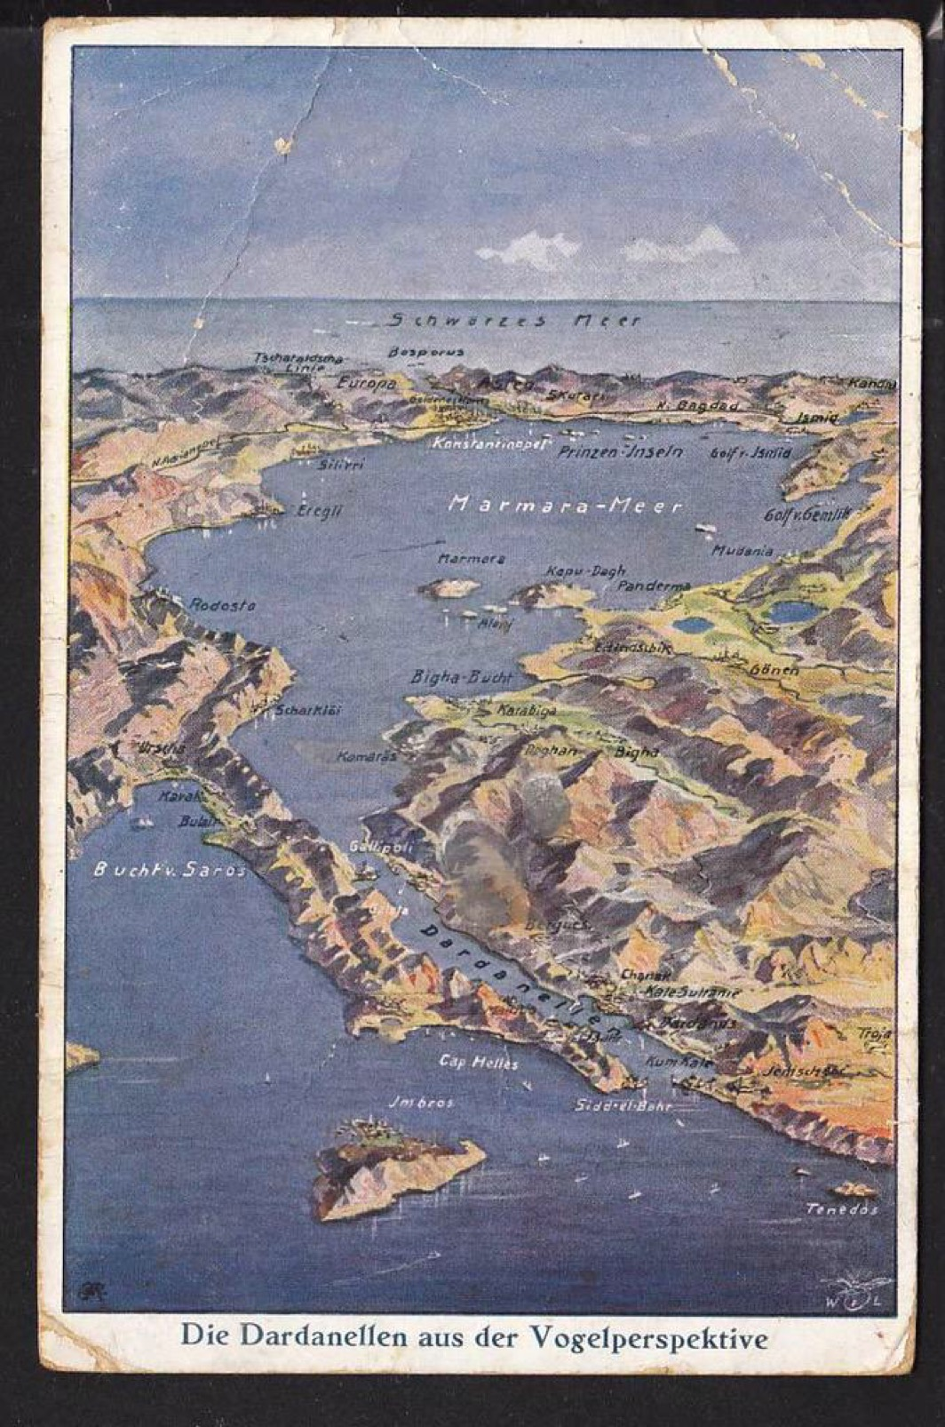

Slide 8
The Naval Campaign
On 17 February 1915, a British seaplane from HMS Ark Royal flew a reconnaissance sortie over the Straits. Two days later, the first attack on the Dardanelles began when a strong Anglo-French task force, including the British battleship HMS Queen Elizabeth, began a long-range bombardment of Ottoman artillery along the coast.

Slide 9
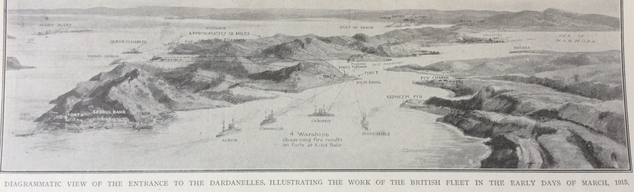

Slide 10
On 18 March 1915, the main attack was launched. The fleet, comprising 18 battleships with a supporting array of cruisers and destroyers, sought to target the narrowest point of the Dardanelles, where the straits are 1 mile (1.6 km) wide.
The French battleship Bouvet was sunk by a mine, causing it to capsize with her crew , over 600 still aboard. Minesweepers manned by civilians, under the constant fire of Ottoman shells, retreated, leaving the minefields largely intact. HMS Irresistible and HMS Inflexible were critically damaged by mines, although there was confusion during the battle about the cause of the damage—some blamed torpedoes. HMS Ocean, sent to rescue the Irresistible, was also damaged by an explosion, and both ships eventually sank. The French battleships Suffren and Gaulois were also damaged.

Slide 11
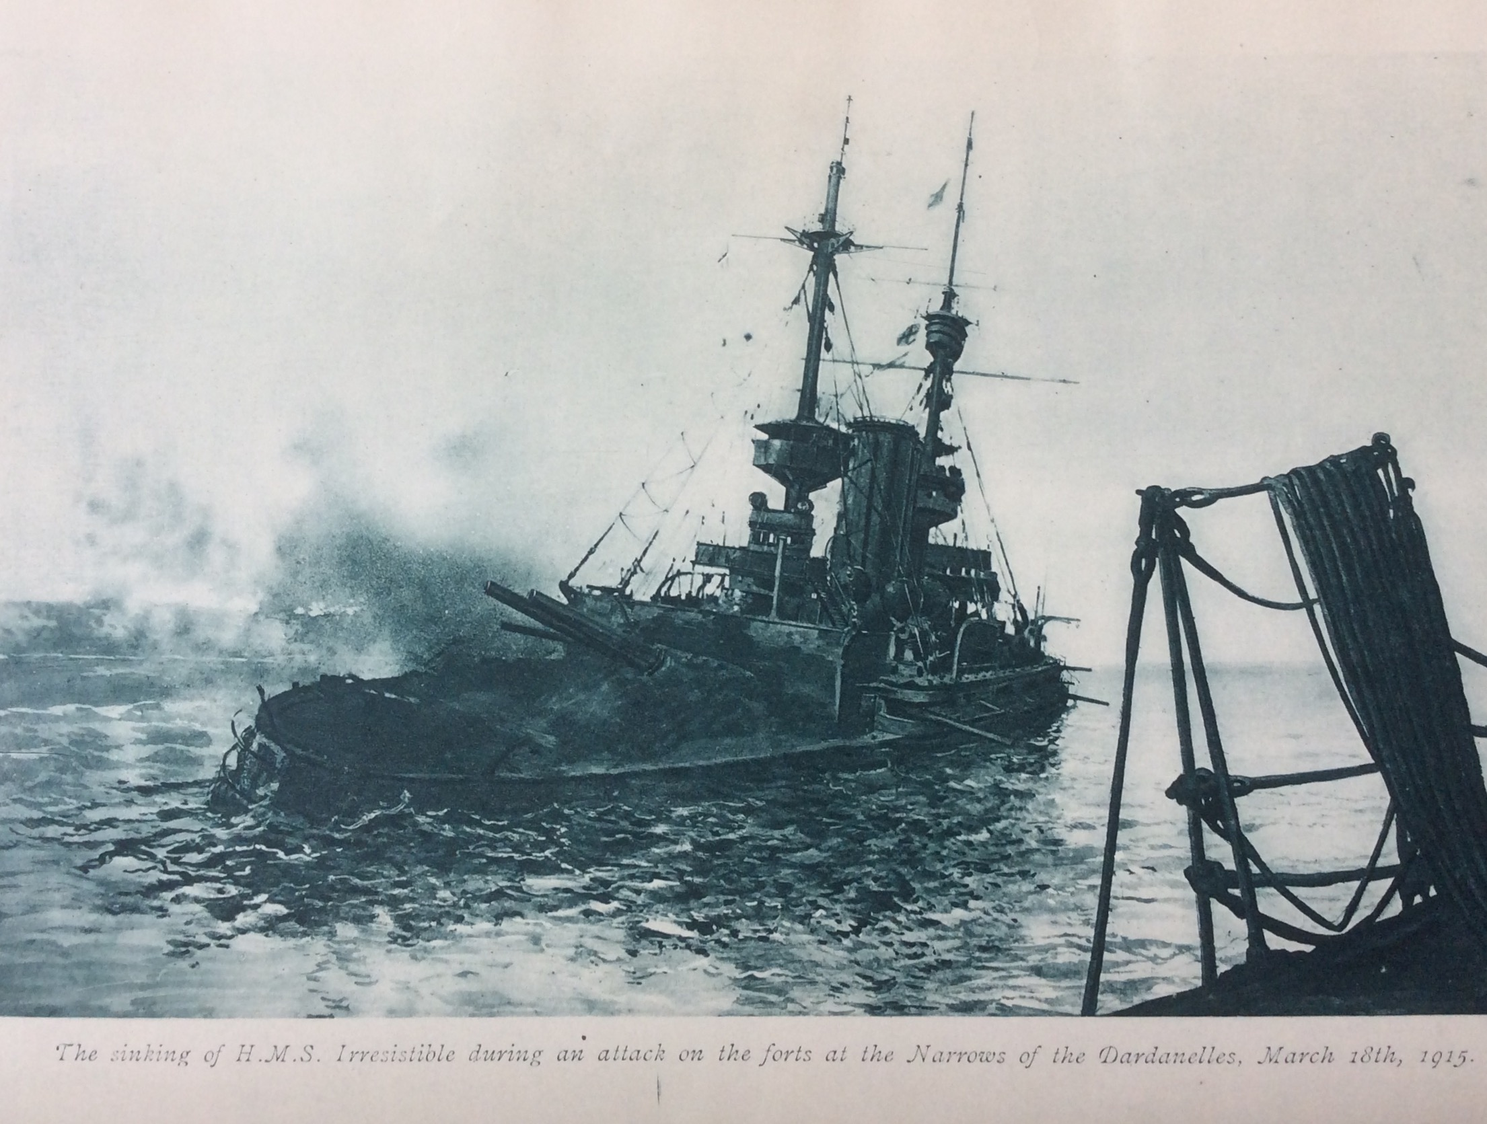

Slide 12
Mediterranean Expeditionary Force
Australian and New Zealand Army Corps (ANZAC), which comprised the all-volunteer Australian 1st Division and the New Zealand and Australian Division under the command of Lieutenant General William Birdwood. The ANZAC troops, along with the regular British 29th Division, the Royal Naval Division and the French Oriental Expeditionary Corps, consisting of "metropolitan" and colonial troops, were subsequently placed under Hamilton's command. With only five divisions the operation would be complicated by the limited forces available, the rugged terrain of the peninsula and the small number of suitable landing beaches, as well as severe logistical difficulties. As the campaign progressed, the troops of the MEF would eventually be supported by about 2,000 civilian labourers from the Egyptian and Maltese Labour Corps.

Slide 13
"Turkish soldiers as a rule manifest their desire to surrender by holding their rifle butt upward and by waving clothes or rags of any colour. An actual white flag should be regarded with the utmost suspicion as a Turkish soldier is unlikely to possess anything of that colour."

Slide 14
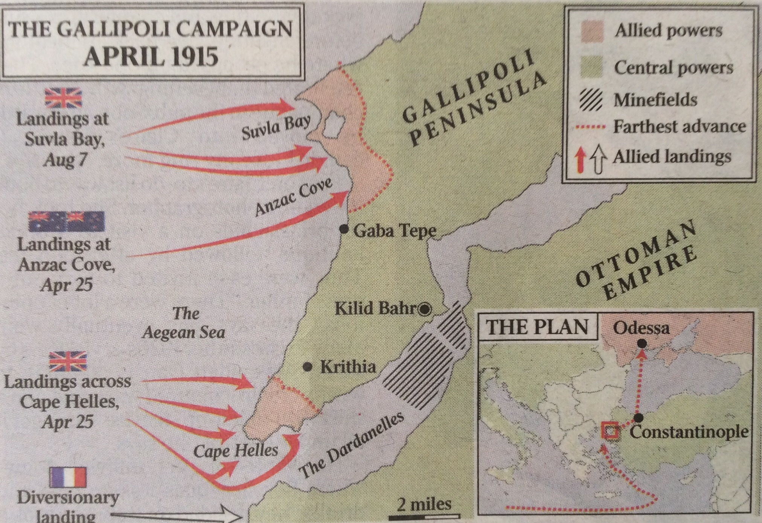

Slide 15
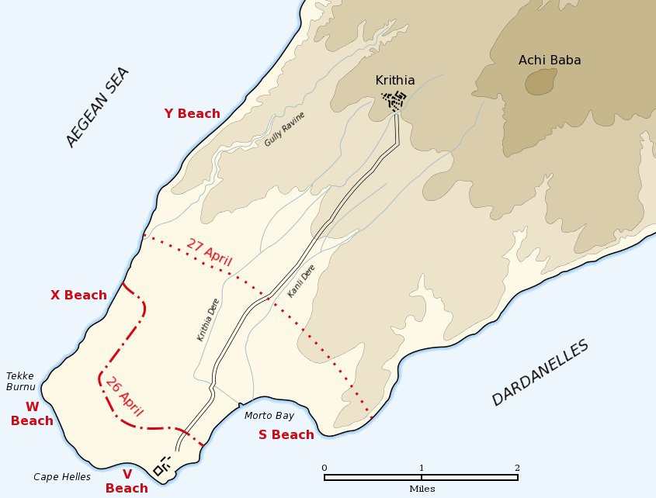

Slide 16
S Beach
Four trawlers, each with six lifeboats in tow, made slow progress against the Dardanelles current and mine sweepers in the Straits but Ottoman artillery on the Asiatic shore fired at other targets and the trawlers came inshore without incident and when the trawlers reached the shallows the tows were cast off. The landing party of three companies of the 2nd Battalion, South Wales Borderers covered by the battleship Cornwallis made landfall under fire from the Ottoman platoon in a trench half-way up the cliff. Two companies landed on the beach and one climbed the cliffs at Eski Hissarlik point to capture de Tott's Battery.

Slide 17
X beach
X Beach was 200 yards long under a low crumbling cliff on the Aegean shore around from W Beach, about 1-mile above Tekke Burnu. No Ottoman defences had been built and only twelve soldiers guarded the beach. The Ottoman party was stunned by the bombardment from Implacable after the troops bound for W Beach had disembarked and the four tows had sailed parallel to the battleship until it was 500 yards from the shore. The landing party had reached the shore and climbed to the top of the cliff with no casualties by 6:30 a.m. when the tows returned to collect the rest of the battalion.

Slide 18
Y Beach
The sea at the shore was deep enough for boats to sail within a few yards and the coast was a steep cliff about 150 feet high, with two gullies giving easy access to the top. The area was undefended and the nearest Ottoman troops were two platoons 1-mile south.

Slide 19
V Beach
1st Battalion, Royal Dublin Fusiliers which landed from ships boats that were towed or rowed ashore.
The rest were landed from a Trojan horse, the SS River Clyde, a 4,000-long-ton converted collier.
The ship held two thousand men; the 1st Battalion of the Royal Munster Fusiliers plus two companies of the 2nd Battalion, the Hampshire Regiment (from the 88th Brigade) and one company of the Royal Dublin Fusiliers.

Slide 20
W Beach
The Ottomans had mined the beach and laid extensive barbed wire entanglements, including one along the shore and trip wires just under the surface of the water, a few yards offshore. Trenches on the high ground overlooked the beach and two machine-guns were hidden in the cliffs, to cover the wire in enfilade. The ridge beyond the centre of the beach was commanded by entrenchments on higher ground to the north-east and south-west and 600 yards away lay one of two redoubts close to Hill 138, both extensively wired and behind slopes with no cover.

Slide 21
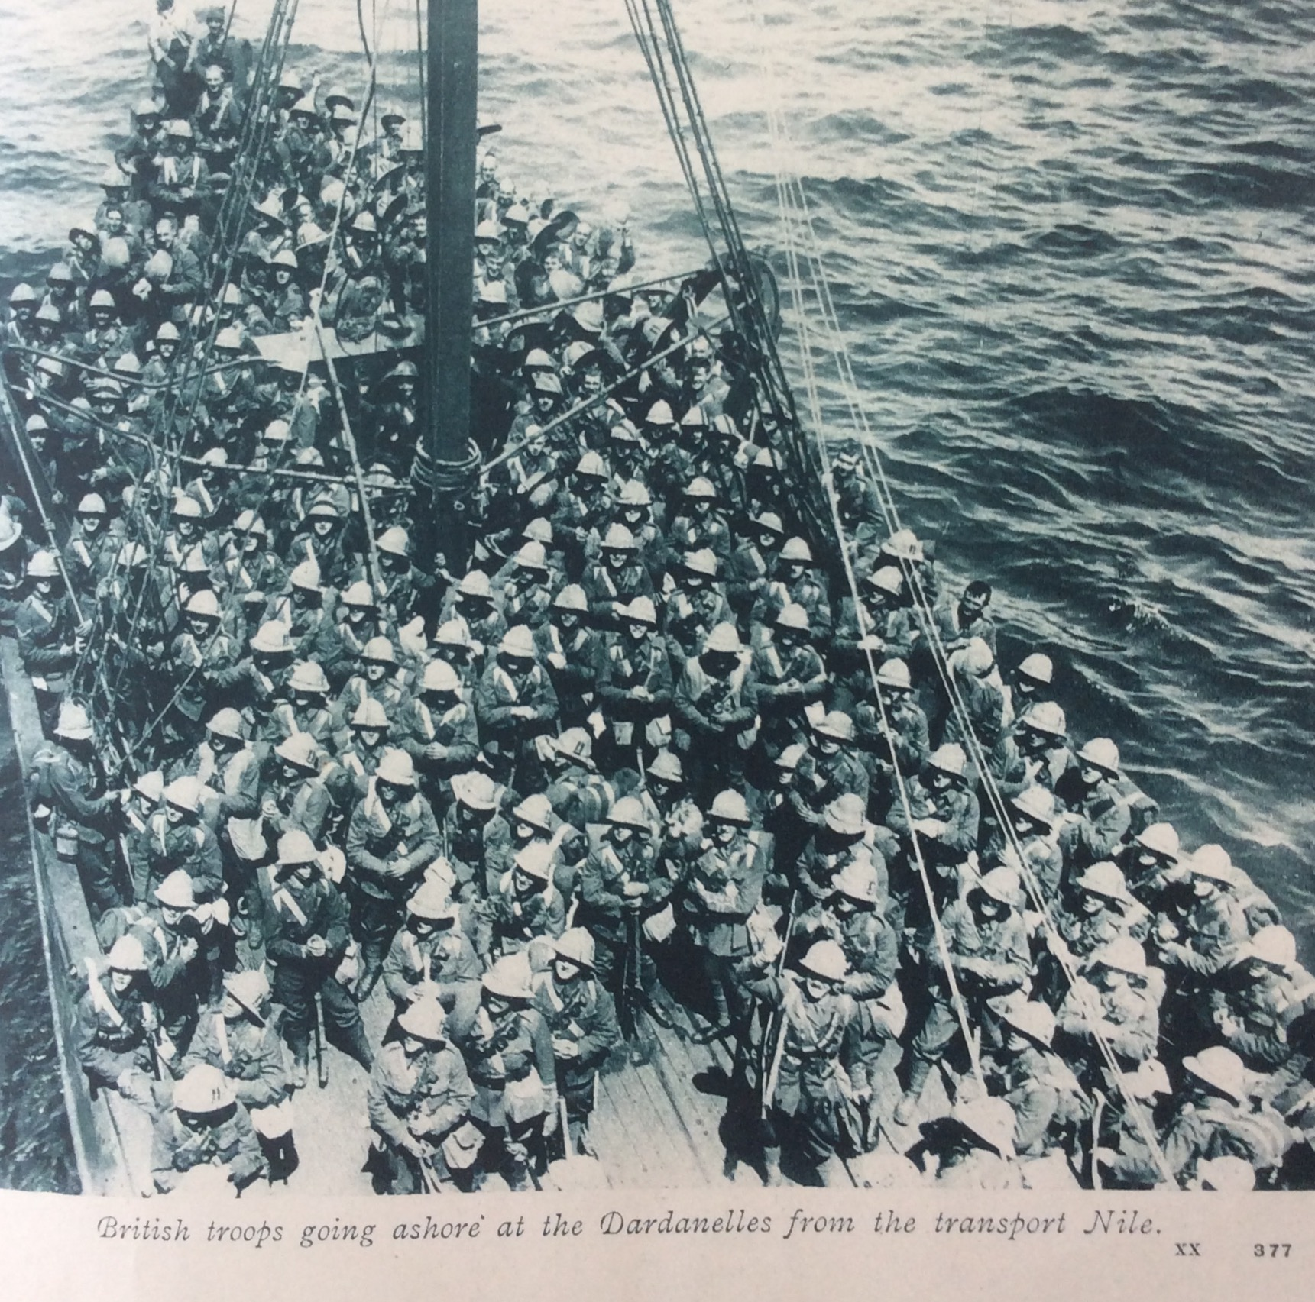

Slide 22
The 1st Battalion of the Lancashire Fusiliers were embarked in the cruiser Euryalus and the battleship HMS Implacable, which took up positions off the beach. The troops transferred to thirty-two cutters at about 4:00 a.m. and Euryalus closed in on the beach at around 5:00 a.m. At 6:00 a.m. the six tows from Euryalus sailed towards the shore, in line abreast at 50 yards intervals, the tows from Implacable to the left. As the tows reached to within 50 yards of the shore the tows were cast off and the sailors in the cutters began to row. The shore had been silent but as the first boat landed, Ottoman small-arms fire swept the British and caused many casualties. Euryalus and Swiftsure lifted their bombardment ten minutes before the British landed and the Ottoman infantry had been able to emerge from cover. The survivors jumped from the cutters and tried to rush ashore but many leapt into deep water and sank under the weight of their equipment. The preliminary bombardment had not cut the wire along the shore and the surviving Fusiliers were fired on from three sides as they cut the wire or crawled underneath.

Slide 23
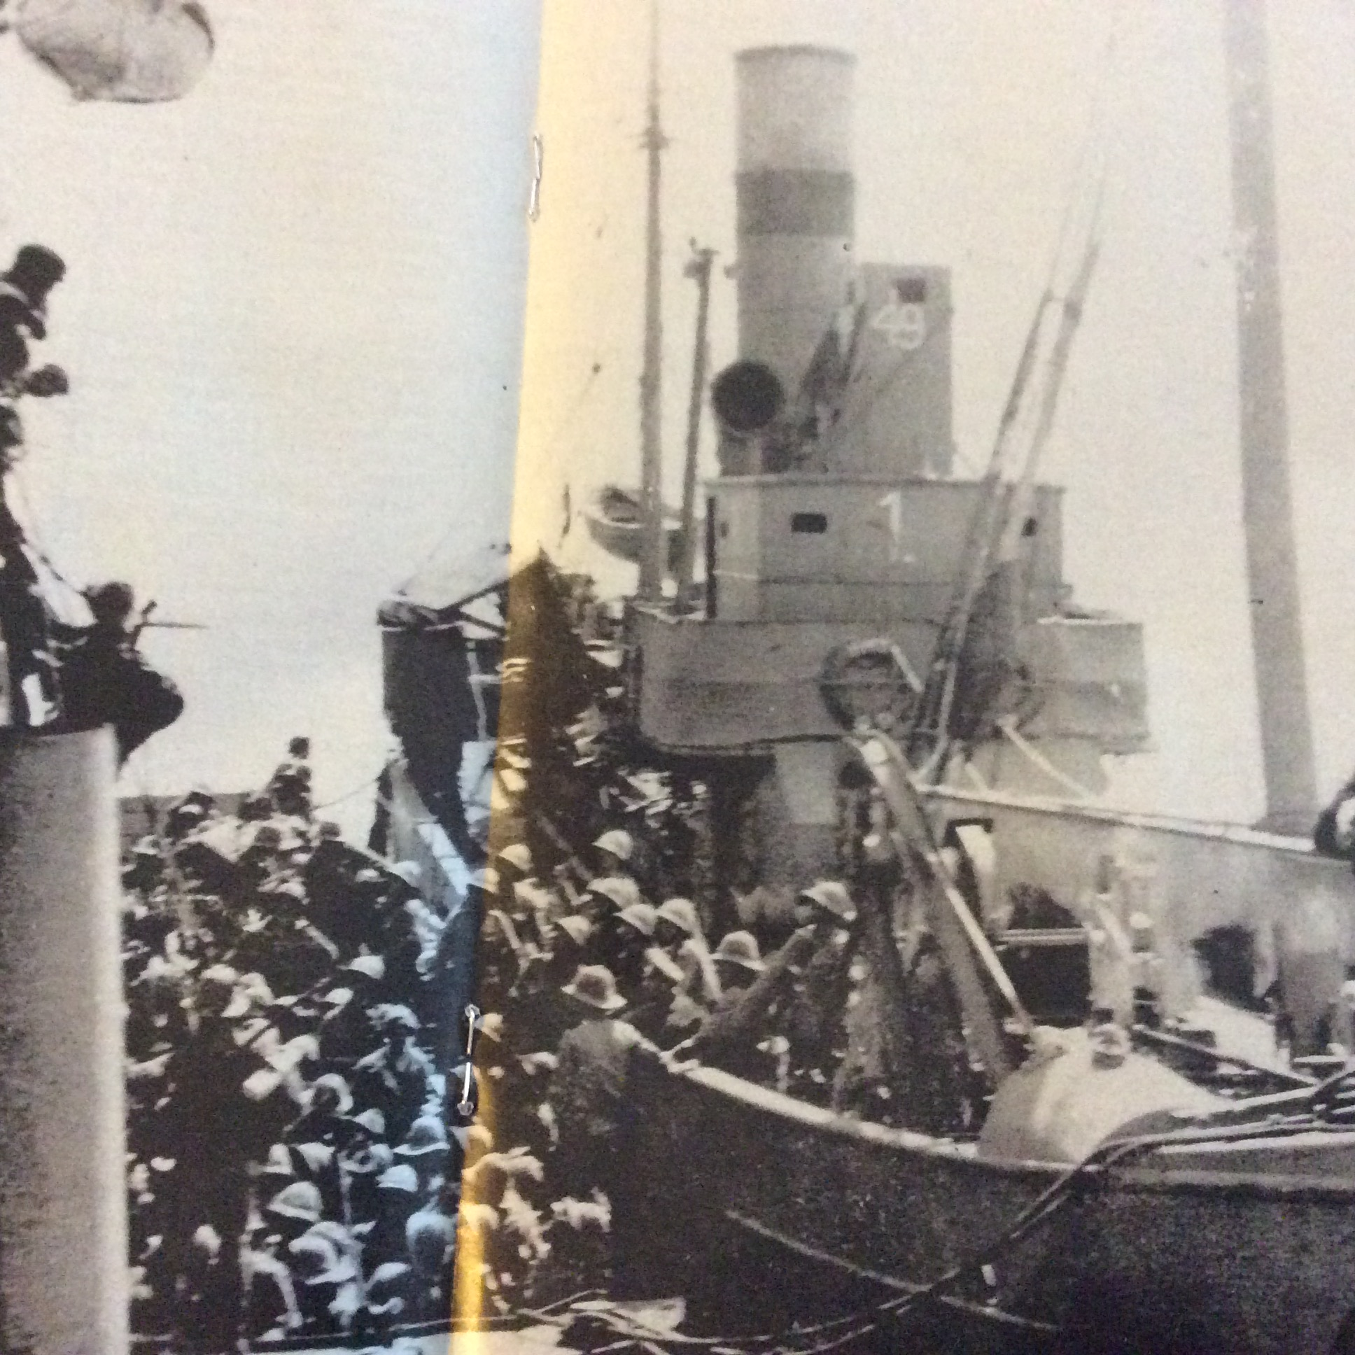

Slide 24
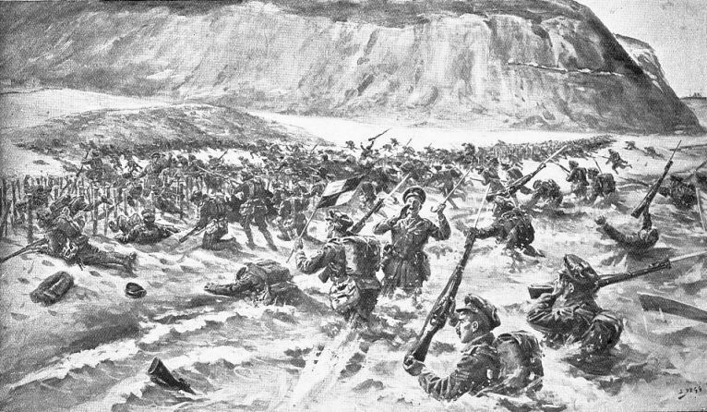

Slide 25
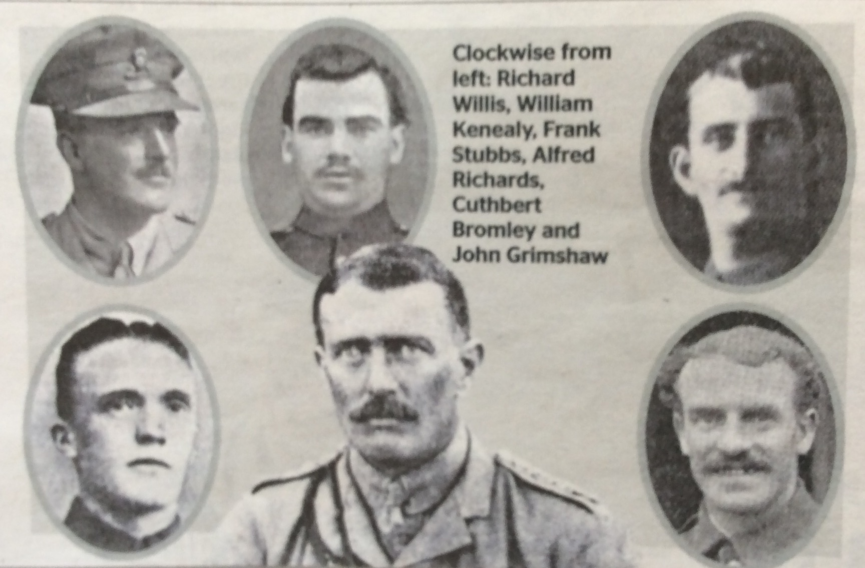
6 VCs before breakfast

Slide 26
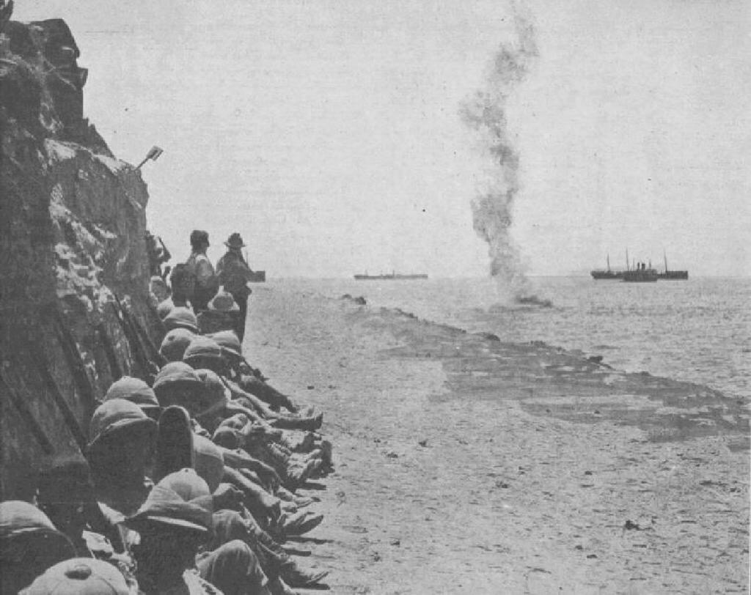

Slide 27
By the morning of 25 April 1915, out of ammunition and left with nothing but bayonets to meet the attackers on the slopes leading up from the beach to the heights of Chunuk Bair, the 57th Infantry Regiment received orders from Kemal, commanding the 19th Division: "I do not order you to fight, I order you to die. In the time which passes until we die, other troops and commanders can come forward and take our places". Every man of the regiment was either killed in action or wounded.

Slide 28
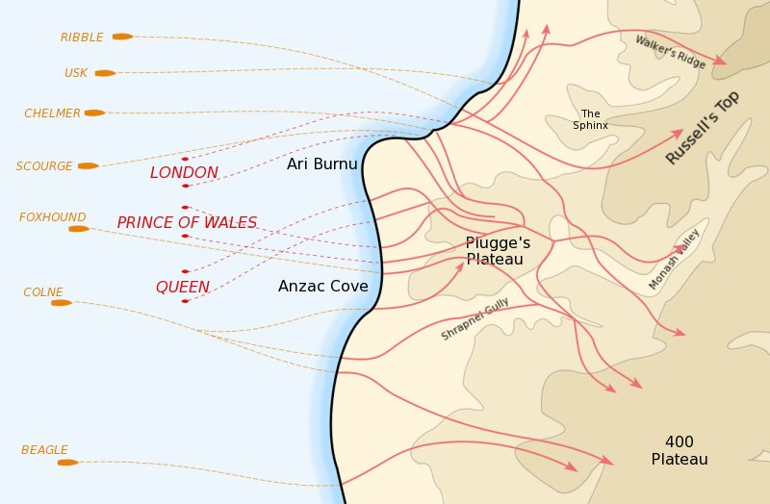

Slide 29
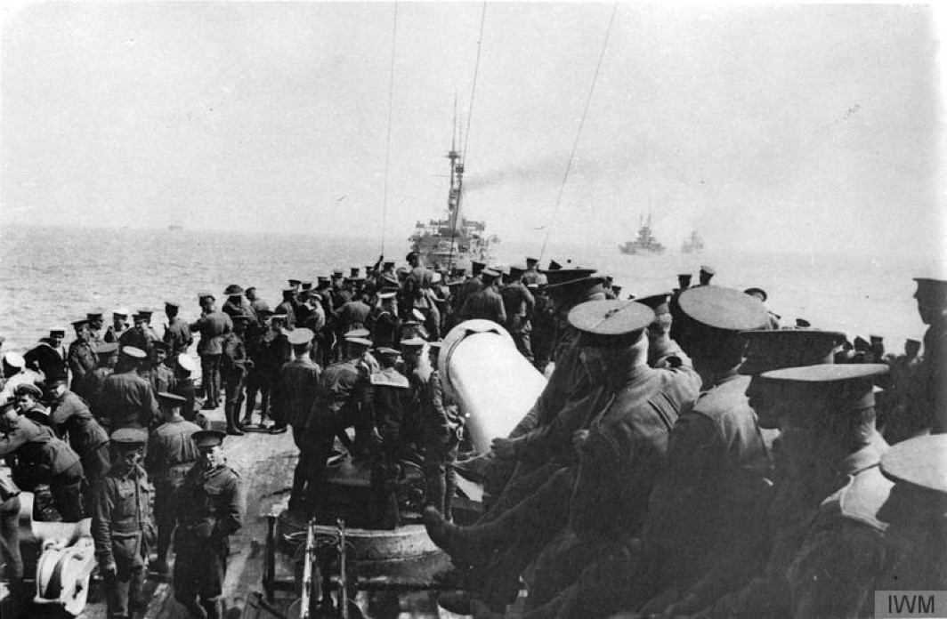

Slide 30
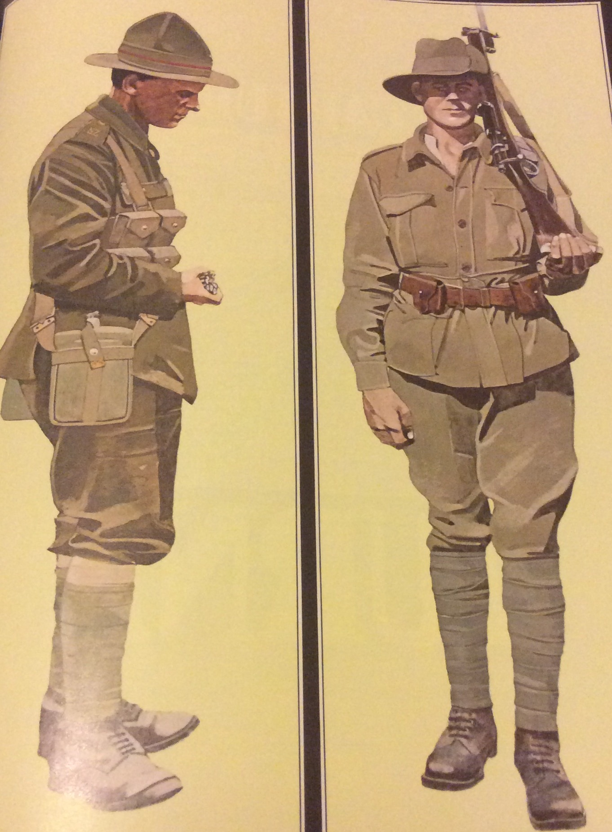

Slide 31
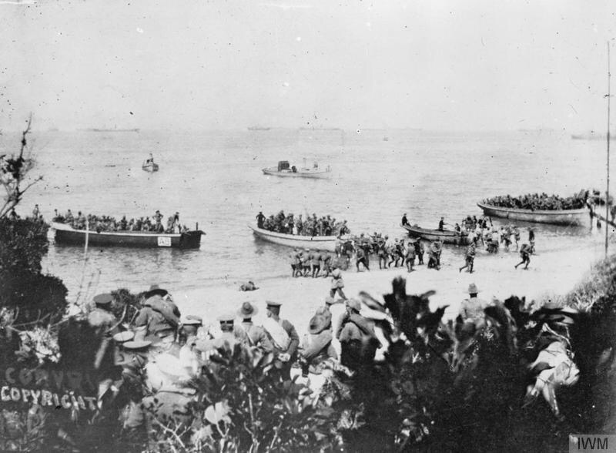

Slide 32
The landing at Anzac Cove (Gaba Tepe)
The assault troops, mostly from the Australian and New Zealand Army Corps (ANZAC), landed at night on the western (Aegean Sea) side of the peninsula. They were put ashore one mile north of their intended landing beach. In the darkness, the assault formations became mixed up, but the troops gradually made their way inland, under increasing opposition from the Ottoman Turkish defenders. Not long after coming ashore the ANZAC plans were discarded, and the companies and battalions were thrown into battle piece-meal, and received mixed orders. Some advanced to their pre-designated objectives while others were diverted to other areas, then ordered to dig in along defensive ridge lines.
Although they failed to achieve their objectives, by nightfall the ANZACs had formed a beachhead, albeit much smaller than intended. In places they were clinging onto cliff faces with no organised defence system. Their precarious position convinced both divisional commanders to ask for an evacuation, but after taking advice from the Royal Navy about how practicable that would be, the army commander decided they would stay. The exact number of the day's casualties is not known. The ANZACs had landed two divisions but over two thousand of their men had been killed or wounded, together with at least a similar number of Turkish casualties.

Slide 33
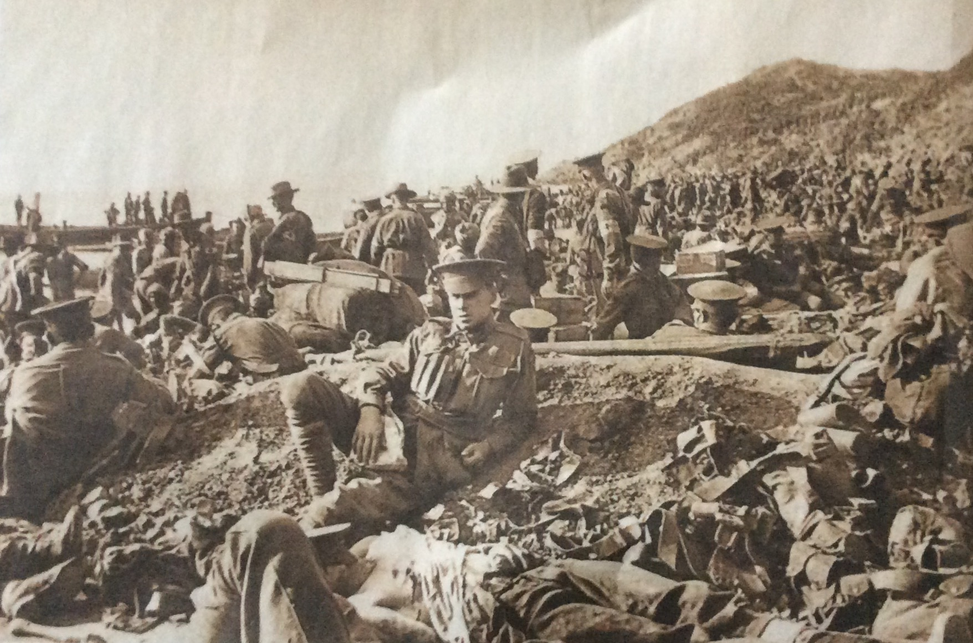

Slide 34
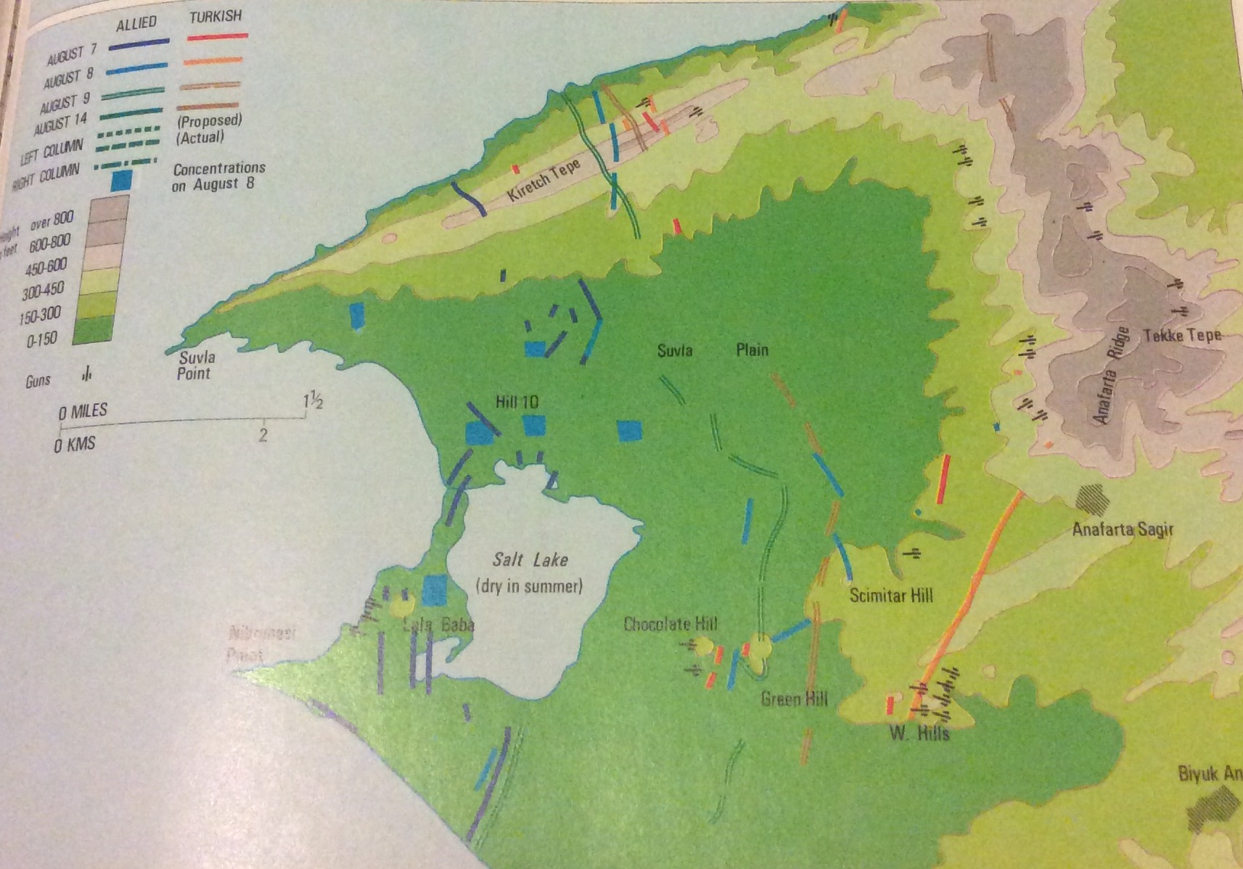
Suvla Bay August 6th 1915

Slide 35
Landing at SEDDULBAHIR 6th August 1915
An attack in the region of Seddulbahir was planned to puzzle the Turkish unit and to prevent the support by units to the main points of the attack. The attack was going to be charged to the trenches in both sides of Kirte Deresi.
Many casualties were caused by Turkish artillery fire before the attack began. The infantry attacked at 03:50 and suffered heavy casualties as they approached toTurkish trenches. The 88th Brigade was destroyed and had to drawback from the trenches they captured before. Within this period, the 88th Brigade lost 2000 soldiers which was 3000 in the beginning.

Slide 36
Private Thomas Edgar Russell – 19893 4th Battalion Worcestershire Regiment. He was the son of John and Ada Russell, of 53, King's Road, King's Heath, Birmingham. He died on 6th August 1915 and is remembered on the Helles Memorial.

Slide 37
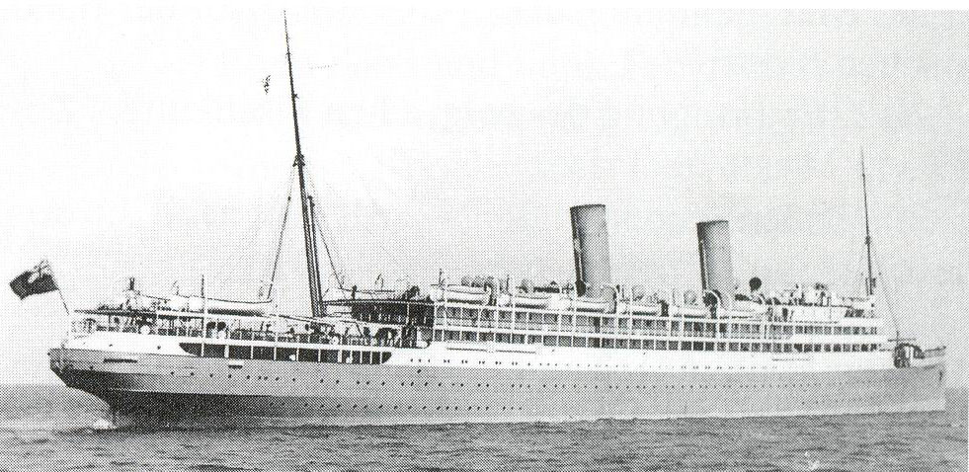
HMT ROYAL EDWARD

Slide 38
On the morning of 13 August, Royal Edward passed the British hospital ship Soudan, heading in the opposite direction. Oberleutnant zur See Heino von Heimburg in the German submarine UB-14 was off the island of Kandeloussa and saw both ships. He allowed Soudan to pass unmolested, and focused his attention on the unescorted Royal Edward some 6 nautical miles (11 km) off Kandeloussa. He launched one of UB-14‍ '​s two torpedoes from about a mile (2 km) away and hit Royal Edward in the stern. She sank by the stern within six minutes with 935 casualties.

Slide 39
Private Charles Henry Hunt – 11826 2nd Battalion Hampshire Regiment. He was the son of Alfred William and Ellen Hunt, of 3, Springfield Drive, High Street, King's Heath, Birmingham. He died aged 20 on 13th August 1915 and is remembered on the Helles Memorial.

Slide 40
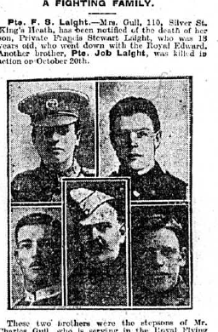
Private Francis Stewart Laight – 11866 2nd Battalion Hampshire Regiment. He was the son of Laura Gull (formerly Laight), of 118, Zilcote Road, Bearwood, Smethwick, and the late Job Laight. He died aged 18 on 13th August 1915 and is remembered on the Helles Memorial.

Slide 41
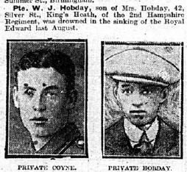

Slide 42
9th Battalion Royal Warwickshire Regiment
9th(Service) Battalion, The Royal Warwickshire Regiment was raised at Warwick in August 1914 as part of Kitchener's First New Army and joined 39th Brigade, 13th (Western) Division which assembled on Salisbury Plain. 39th Brigade moved to Basingstoke in January 1915. Near the end of February the Division concentrated at Blackdown in Hampshire. They moved to the Mediterranean from the 13th of June 1915 landing at Alexandria then moving to Mudros, by the 4th of July to prepare for a landing at Gallipoli. The infantry landed on Cape Helles between the 6th and 16th of July to relieve 29th (Service) Division. They returned to Mudros at the end of the month, and the entire Division landed at ANZAC Cove between the 3rd and 5th of August. They were in action in The Battle of Sari Bair, The Battle of Russell's Top and The Battle of Hill 60, at ANZAC.

Slide 43

Private Joseph Henry Summers – 5408 9th Battalion Royal Warwickshire Regiment. He died on 13th August 1915 and is remembered on the Helles Memorial.

Slide 44
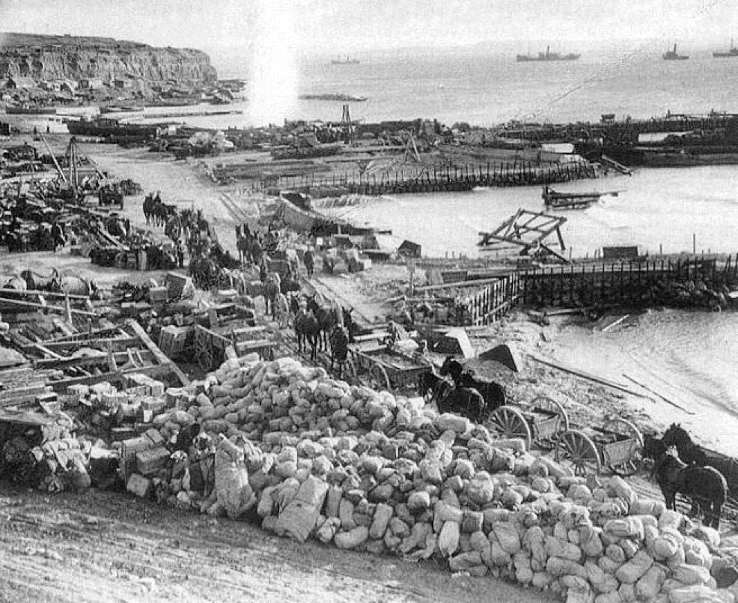
Evacuation 7th January 1916

Slide 45
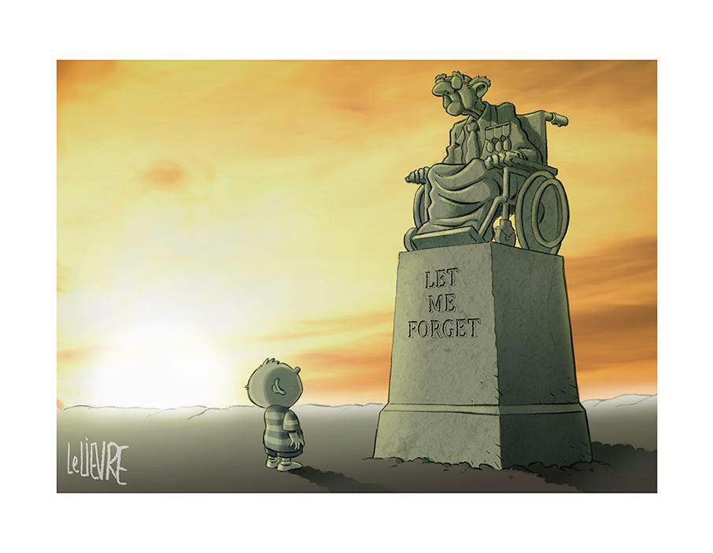

Slide 46


